Slide 1
Creating a professional brand & networking with LinkedIn
By: Tony Rodriguez ‘79
December 5, 2025
Notes:
Good evening fellow Tigers & welcome to our 1st Class of 2029-1979 Mentoring Event
I am Tony Rodriguez and our class President, Prentis Hall is joining me as I share some ideas for utilizing LinkedIn and Princeton Career resources to help you develop, or enhance, your professional brand and network more effectively to achieve career goals.
This workshop is being recorded and will be shared with your class for future reference and follow up as needed.
The presentation includes several links to helpful career resources which you can activate in "presentation" mode.
Prentis and I have also shared our LinkedIn profiles in case you wish to connect with us and our emails appear on the last chart for those that wish to contact us directly.
My profile describes academic credentials & professional career path, as well as volunteer activities, after retiring from Warner Bros Entertainment in 2010.
My volunteer experience working with students EVOLVED from my Princeton activities conducting admission interviews and serving on the Alumni Board which brought me to campus 3x/year & gave me exposure to student mentoring which was magnified when I expanded alumni volunteers (on campus) and via Zoom virtual meetings. In 2019, the Class of 1979 launched the FLi student/alumni remote mentoring program as its 40th reunion legacy project; this provided experienced mentors to work with our grandchild class of 2029 mentees.

Slide 2
Agenda
Building effective LinkedIn profiles
Leveraging LinkedIn in your job search
Search functionality-LinkedIn & Tigernet
Princeton Career Development Resources:
Advisors, Career Compass, Career Chats
Networking best practices & etiquette
Notes:
This is our agenda which will focus on two primary objectives.
The first is to help you create a professional brand (aka "profile") for LinkedIn which you can then utilize to network more effectively using the search & connection functionality of LinkedIn as well as TigerNet and other Princeton alumni resources we will discuss.
We will provide several live examples of fellow tigers profiles as well as resources to help you better leverage LinkedIn and the Career Development Office advisors and alumni connection websites (hotlinks included in a subsequent chart).

Slide 3
Key Linkedin Profile Features
Professional looking photo & background
Summary ("About") – unique attributes & networking objectives
Academic coursework, internships, activities
Key jobs/activities – highlight roles, responsibilities & results
Recommendations & skills
Notes:
A LinkedIn profile is your online professional brand which will be searched by hiring companies and shared by your network connections when making "warm" introductions to your desired contacts, so it needs to make you stand out as someone worth speaking with about relevant employment opportunities.
Your profile summary ("ABOUT") clarifies what you are interested in doing professionally and learning from internships. State this in the "About" summary to help your network contacts identify the most relevant contacts for warm introductions.
You can achieve these objectives for your branding with an effective profile beginning with a professional looking photo. You can frame your picture to make it stand out. Attire should be more formal than casual selfies; the level of formality can vary depending on target profession and industry.
Many profile readers focus on your summary at the top ("About" section) which recaps your most vital attributes and networking objectives. The next chart contains profiles of some of my tiger mentees who recently graduated as well as a current junior and senior.
College profiles build branding with the most job-relevant academic courses and extracurriculars/jobs to date. Princeton is a global academic badge, so demonstrate what you accomplished here. As you progress through college and internship experiences the relevance & value of these profile components will enhance your brand considerably so update it constantly. Ask work colleagues & professors for LinkedIn recommendations after you earned their respect with performance.

Slide 4
LinkedIn Profile Examples from Princeton Students/ Alumni
https:www.linkedin.com/in/loan-t-le-7270753
http://linkedin.com/in/pranaya-anshu-330b28132
https://www.linkedin.com/in/sarina-krishnan
https://www.linkedin.com/in/elizabeth-poku
https://www.linkedin.com/in/nicoleptorres
https://www.linkedin.com/in/chloe-hc-lau
https://www.linkedin.com/in/prentis-hall-033549
http://linkedin.com/in/tonyrodriguez79
Notes:
Examples of professional branding profiles from some of my Tigers: illustrate branding with Princeton coursework, extracurriculars, internships, jobs, grad school.
Loan Le-Mechanical & Aerospace Engineer '07,'13, '15-AWS Robotics Snr Manager
Pranaya Anshu '19 – Economics. AWS Marketing Mgr & Wharton Finance MBA–see internships
Sarina Krishnan '24 – Politics/Apollo Financial Analyst – internships & extracurriculars
Elizabeth Poku '24- Economics/Blackstone Financial Analyst – Internships & XTs
Nicole Torres '26 –SPIA-Internships & XTs
Chloe Lau '27 – Cognitive Science/minors in AI, etc. "About" and Virtual XTs (Fellowships).
Prentis Hall-Chemical Engineer; MBA-Marketing. Entrepreneurial Business Builder
Tony R.– Economics/Romance Languages; MBA-Accounting. Fortune 500 Global C-Suite/Gen. Mgmt., Board Director; Student Advocate
I added profiles for Prentis & myself for longer term career perspective and give you the opportunity to connect with us. Networking on LinkedIn is amplified by quality Connections; focus on your strategic connections & nurture those relationships.

Slide 5
Utilizing LinkedIn’s & Princeton's search functions
Search feature filters: professions, industries, companies
Tighten focus by using: geography, schools, and connections
1st & 2nd level connections are most effective ("warm")
Prioritize relevant profiles from search: target networking contacts
LinkedIn search tool - for Princeton University alumni
TigerNet – Career Search function ("Alumni Directory")
Princeton: Alumni Profiles | Career Compass , and
Career Chats | Center for Career Development
Notes:
Search strategy – identify what/who you are looking for: profession/industry, company.
LinkedIn has robust search function, across all professions and alumni affiliations.
LinkedIn identifies your connections related to your search (warm introductions).
TigerNet more effective for contacting alums (Alumni Directory has email addresses)
Career Compass-Alumni profiles (612) by profession/industry-opted in ("already warm") for Career Chats.
Career Chats provide an opportunity to network in a low-pressure environment ("informational interview) for students interested in learning about:
How alumni navigated their Princeton experience (courses, XTs, internships)
What working in a particular job or field is really like
Tips to prepare for and land internships and jobs
Use these hyperlinks – access in Presentation mode.

Slide 6
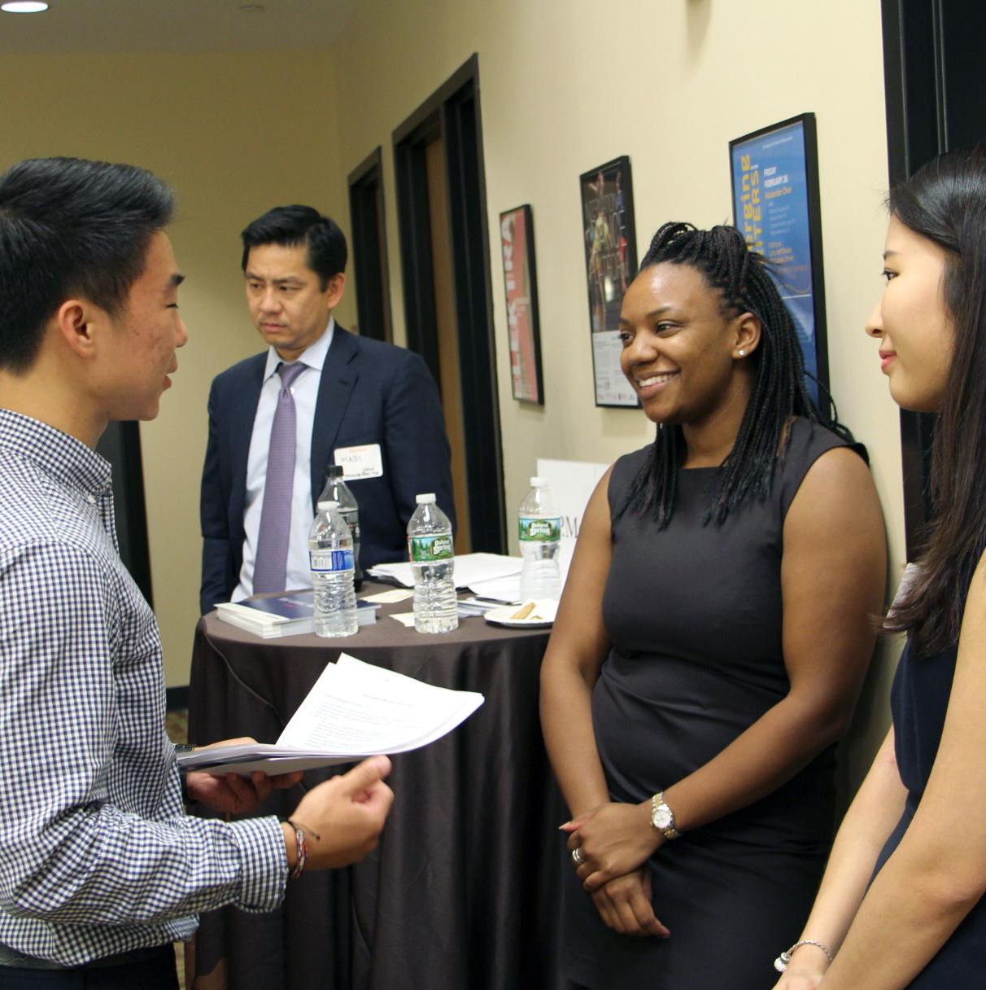
Networking Best Practices
Create a ‘warm’ introduction through mutual connections (i.e. professors, mentors, and alums)
Set-up a time to talk over the phone or Zoom
Understand how and when to contact relevant connections
Follow up when/as warranted
Notes:
After using various search functions to identify your key connection targets, use these best practices to network effectively.
Happy to answer any questions before we cover some the more detailed "Five Step Guide to Networking" from Career Development Office which follows.....

Slide 7
Five Step Guide to Networking
Step 1: Lay the groundwork:
Know your "why" - clarify goals/objectives for connecting with others.
Figure out your "who" - people with whom you would like to connect and learn more about work that interests you.
Decide on "what" approach to take: formal, informal, and primary purpose: informational...(can often result in)...job opportunities.
Step 2: Find Contacts:
Build list of potential connections in areas that interest you (sources: LinkedIn, TigerNet, Career Compass Alum Profiles, Career Chats).
Notes:
#1 – Be specific as possible on "Why" & "Who" to clarify job/career goals.
"What" approach you take should focus on relevant (shared) interests in order to first build rapport that can lead to ongoing mentoring and warm introductions.

Slide 8
Five Step Guide to Networking
Step 3: Reach out:
Set up a meeting, preferably through warm introduction, otherwise email to ask for chance to set up in-person, phone, or virtual conversation.
Step 4: Prepare & conduct yourself professionally:
Confirm logistics: first impressions matter...a lot!
Do your homework; brainstorm questions &
impressive examples to support your brand.
Be professional and engaged (positive, enthusiastic)
Notes:
#3 Princeton alums very likely to say yes if you are focused and clear on (relevant) objectives. Help them to help you.
#4 Logistics and arrangements are your "first audition" - chance to make an impression (good or bad).
Support your brand poistioning by leveraging an impressive profile (your virtual brand communication).

Slide 9
Five Step Guide to Networking
Step 5: Manage (nurture) your contacts:
Follow through on conversation outcomes (suggestions, next steps)
Track your progress & determine when to circle back to connection
Keep in touch with updates/results, possibly new questions.
Continue conversations if BOTH of you are interested.
If no further dialogue is warranted; leave a good feeling ("open door").
Source: Career Development Office:
https://careerdevelopment.princeton.edu/node/882
Notes:
#5 Contacts are key relationships that deserve proper care.
Managing them properly is about nurturing your relationships; both tactical (one off) & strategic (longer term) - don't GHOST when done!!!
Use hyperlink to more Career Development resources; so much more value than what we had 50 years ago, but we had much cooler music (WPRB DJ).

Slide 10
Thanks!
You can find us at:
Tonyrodriguez@alumni.princeton.edu
Prentis.hall@gmail.com
Princeton Career Guides:
Notes:
Tap hotlink for career guides and use our emails to follow up.
Any QUESTIONS?

